Slide 1


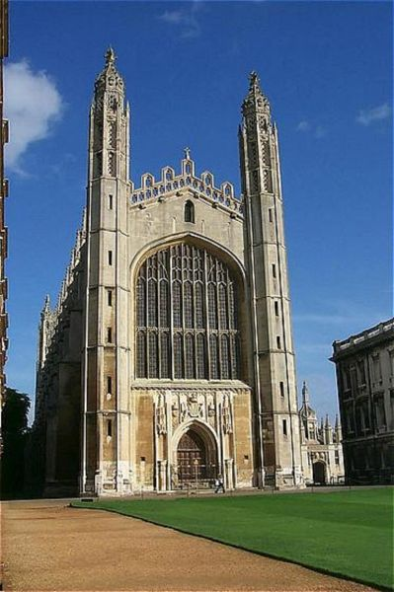


The Honours Programme
Information Evening
Year 11

Slide 2
The goal of the
Honours Programme
The goal of the programme is to provide support and guidance on making an application to one of the UK’s top universities, especially Oxford and Cambridge, but also other Russell Group universities.

Slide 3
The Russell Group
The Russell Group represents 24 leading UK universities which are committed to maintaining the very best research, an outstanding teaching and learning experience and unrivalled links with business and the public sector.

Slide 4
Russell Group universities
University of Birmingham
University of Bristol
University of Cambridge
Cardiff University
Durham University
University of Edinburgh
University of Exeter
University of Glasgow
Imperial College London
King's College London
University of Leeds
University of Liverpool
London School of Economics & Political Science
University of Manchester
Newcastle University
University of Nottingham
University of Oxford
Queen Mary, University of London
Queen's University Belfast
University of Sheffield
University of Southampton
University College London
University of Warwick
University of York

Slide 5


The Oxbridge Candidate
High attainer (outstanding GCSE and A Levels)
Independent learner (e.g. wider reading)
Self-motivator (explore opportunities beyond the curriculum)
Critical thinker (analysis/evaluation/synthesis)
Creative thinker (problem-solving)

Slide 6
What an offer may be based on
UCAS:
Qualifications
Predicted grades
Personal statement
Reference
Additional:
Admissions tests
Interview
Sample written work
SAQ (Cambridge)

Slide 7
Qualifications
No required number of GCSEs (but Oxford look at contextualised GCSE results).
A*A*A – AAA (Oxbridge)
A*AA – AAB (other Russell Group)
Some courses require or recommend specific subjects.

Slide 8
Making A Level Choices

Slide 9
Planning Ahead
GCSEs
A levels
Degree
Career

Slide 10
Backwards Thinking…
GCSEs
A levels
Degree
Career

Slide 11
General guidance
A Level subjects divide roughly into two types:
  Arts/Social Sciences
  Mathematics/Sciences
Knowing where your strengths lie, and preferably what kind of degree you want to do (and, even better, what kind of career you want to go into) will make your choices easier.

Slide 12
If you are interested in Arts/Social Sciences…
English Literature
History
Languages
Maths
Other good choices, likely to be useful:
  An additional Language, Ancient History, Classical Civilisation, Economics, Further Maths, Geography, Philosophy, Religious Studies, Sciences (Biology, Chemistry or Physics)
Useful depending on the course you are applying for:
      Archaeology, Citizenship, English Language, Environmental Science, Government & Politics, History of Art, Law, Music, Psychology, Sociology

Slide 13
If you are interested in Mathematics/Sciences…
Biology
Chemistry
Maths
Physics
Also very useful: Further Maths
An essay-based or ‘contrast’ subject can be useful
Useful depending on the course you are applying for:
  Computing, Design & Technology, Electronics, Geology, Psychology
Notes:
13

Slide 14
More specific guidance
There are certain subjects that universities expect you to have taken as a pre-requisite to being accepted onto certain degree courses.
These are, of course, very varied depending on the nature of the subject, but also on the university itself.

Slide 15
What to look for…
When looking at degree course entry requirements, look for:
  Essential/expected subjects;
  Desirable/helpful subjects;
  Suggested subject combinations;
  Expected or suggested GCSEs;
  Specific grade requirements (i.e. in a specific subject);
  When the A levels need to have been taken;
  Subjects that are not accepted.

Slide 16
English Language and
Literature (Oxford)
A-levels: AAA
Candidates are expected to have English Literature, or English Language and Literature to A-level... A language or History can be helpful to students in completing this course, although they are not required for admission.
All candidates must also take the English Literature Admissions Test (ELAT) as part of their application.

Slide 17
Law (Oxford)
A-levels: AAA
Candidates are also expected to have at least a C grade in GCSE Mathematics, or other evidence to demonstrate that they are appropriately numerate. We accept any subjects at A-level except for General Studies.
There is no particular advantage or disadvantage to studying Law

Slide 18
Medicine (Oxford)
A-levels: A*AA, in three A-levels taken in one academic year
Candidates are required to have Chemistry (compulsory), plus Biology and/or Physics and/or Mathematics to full A-level.
All candidates must also take the Biomedical Admissions Test (BMAT) as part of their application.

Slide 19
Medicine (Oxford)
Conditional offers for students applying to study Medicine are usually A*AA in three A-levels which must be completed in the same academic year.
Applicants for Medicine are very welcome to take one or more of their A-levels early, and their grades will be taken into account along with all other aspects of their application.
Any conditional offer will be based upon these final three grades.

Slide 20
Medicine (Cambridge)
Although some Colleges consider applicants offering only two science/mathematics subjects at A Level, please note that the success rate of such applicants is much lower. In the past three admissions rounds, 98 per cent of applicants for Medicine offered three or more science/mathematics A Levels and, of these, 23 per cent were successful in obtaining a place. Of the two per cent of applicants who offered only two science/mathematics A Levels, just 10 per cent were successful in gaining a place.
All Colleges require applicants to take the Bio-Medical Admissions Test (BMAT).

Slide 21
Materials Science (Oxford)
A-levels: A*AA (including Mathematics and Physics, with an A* in either Mathematics, Physics or Chemistry)
GCSE-level Chemistry (or Double Science), or an equivalent, is also required. It is highly desirable to have Chemistry to A-level or equivalent, and if it is not studied to A-level or equivalent it is strongly recommended that it is studied to AS-level or equivalent. Most applicants are studying Mathematics, Physics and Chemistry to A-level or equivalent.
Further Mathematics and Design and Technology (Resistant Materials) can be helpful to students in completing this degree programme but are not required for admission.

Slide 22
Natural Science
(Cambridge)
A Level: A*A*A
Please note that in the following 'science/mathematics subjects' refers to Biology, Chemistry, Physics, Mathematics and Further Mathematics. It does not include Psychology.
Essential: At least two science/mathematics A Levels/IB Higher Levels
Highly desirable: A third science/mathematics subject to at least AS Level/IB Standard Level
The more useful combinations are:
A Level Biology + Chemistry + AS Mathematics or Physics
A Level Chemistry + Mathematics + AS Physics
A Level Physics + Mathematics + AS Further Mathematics

Slide 23
*Important*
Check with multiple universities in case they require different subjects, and/or suggest different subject combinations.

Slide 24
Admissions Tests

Slide 25
Medicine, Vet Sci,
Dentistry and Law
Medicine, Veterinary Science, Dentistry:
UKCAT (UK Clinical Aptitude Test)
BMAT (BioMedical Aptitude Test)
Law:
LNAT (Law National Admissions Test)
Cambridge Law Test

Slide 26
Subject-specific tests
CAT (Classics Admissions Test)
ELAT (English Language Admissions Test)
HAT (History Admissions Test)
MAT (Mathematics Admissions Test)
MLAT (Modern Languages Admissions Test)
OLAT (Oriental Languages Admissions Test)
PAT (Physics Aptitude Test)
STEP (Sixth Term Examination Paper)

Slide 27
TSA (Thinking Skills Assessment)
Used by Oxford, Cambridge and UCL.
Tests ‘general academic aptitude’.
Particular focus on problem-solving, critical thinking and writing skills.
Research shows strong correlation between TSA scores and university success.

Slide 28
Interviews
Want to find out about YOU.
Look for general academic excellence and suitability for specific course.
May draw on existing knowledge/understanding of subject.
Will use information in personal statement.
Look for evidence of original thought, problem-solving, thinking ‘on-the-spot’ and ‘outside-the-box’.

Slide 29
EPQ
(from the University of Oxford)
Where applicants have undertaken the Extended Project, this will not be a condition of any offer but the University recognises that the EPQ will provide an applicant with the opportunity to develop research and academic skills relevant for study at Oxford.
Candidates are encouraged to draw upon relevant EPQ experience when writing their personal statement.

Slide 30
Sample Interview Questions

Slide 31

How many ways can you think of to measure the height of a volcano?

Slide 32

If you could invent a new musical instrument, what kind of sound would it make?

Slide 33

Enemy 1 poisons the water in V’s water bottle. Enemy 2 drills a hole in the same water bottle so that the contents trickle out. Later, for want of water, V dies in the middle of the desert.
Who, if anyone, caused V’s death?

Slide 34

If you could save either the rainforests or the coral reefs, which would you choose?

Slide 35

How many Golden Eagles would it take to lift an Elephant?

Slide 36

What can a historian learn from critical assessment of a programme such as EastEnders?

Slide 37

In a world where English is a global language, why learn French?

Slide 38
Personal Statements

Slide 39
Personal statement
Needs to communicate passion and suitability for the course of study.
For top universities: 80-100% about course.
Avoid clichés.
Start planning now!

Slide 40
Things to include
What drew/draws you to the subject.
What aspects of the subject particularly interest you and why.
Reading/watching/listening outside of lessons (books, journals, documentaries, radio, etc).
Work experience, volunteering, etc.
Courses, workshops, summer schools, etc.
Clubs, societies, and other extra-curricular involvement.
Future career plans.

Slide 41
Lutterworth College
Early Applicants

Slide 42
Early Applicant?
Vet
Medic
Dentist
Lawyer
Oxford
Cambridge
Let Mrs Pepper know this is your intention (T2 or email). At the end of this year we will be bringing you to the Year 12 university fayre and you MAY look at starting at EPQ early.

Slide 43

Super-Curricular
Enrichment:
10 Things You Can Do

Slide 44


Competitive Universities and Courses
Deepening and enriching your subject knowledge is a key issue particularly for competitive universities
They want applicants to engage in super- rather than extra-curricular activities.
They will look for evidence of this in the UCAS Personal Statement and at interview
Start doing this as soon in Year 12 as you can

Slide 45

What is Super-Curricular Enrichment?
Cambridge: ‘As our admissions decisions are based on academic criteria, we expect to see evidence of students’ super-curricular activities and wider engagement with their area(s) of academic interest, such as reading and other exploration relevant to the course applied for.’
Mike Nicholson of Bath University: ‘.....universities (are) only interested in enthused, engaged and excellent candidates, rather than second-rate historians who happen to play the flute.’

Slide 46
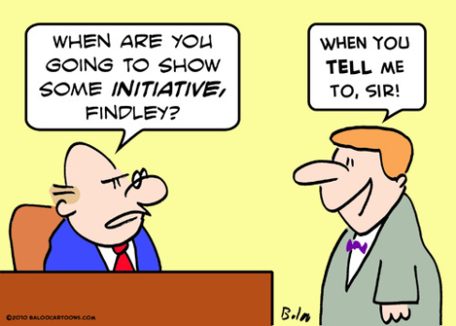
What Type of Student are They Looking for?
Does more than the basic demands of subject spec. and has passion and enthusiasm for the subject
Reads on own initiative
Learns on own initiative
Follows up ideas and leads suggested by school learning
Has developed particular areas of interest within the subject which are explored with genuine enthusiasm
Has developed new areas of interest outside the specification

Slide 47


Talk to Your Subject Teachers and Get their Advice
Wider reading
Websites
Activities and visits
Magazine and journals
Courses and student conferences
Work experience
BUT you can also look out for the following yourself

Slide 48
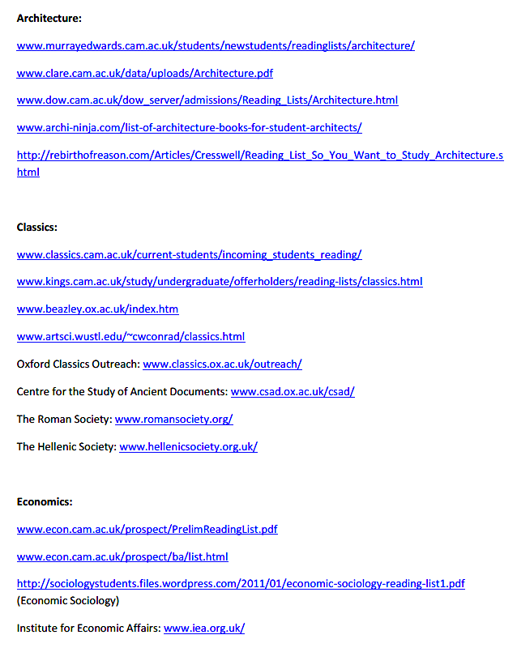
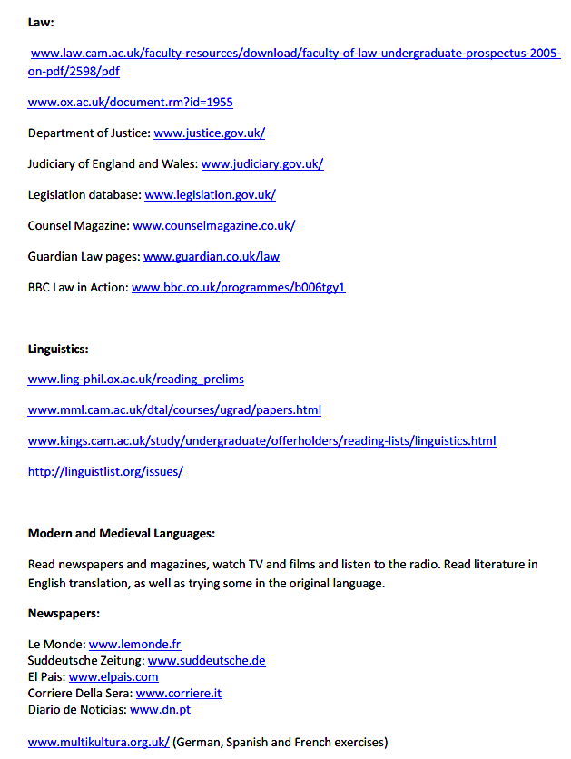
Look for Guidance on Focused Wider Reading
Trinity College Cambridge Suggested Reading by Subject
http://trinityaccess.soc.srcf.net/wp-content/uploads/2012/05/Cambridge-wider-reading-suggestions.pdf

Slide 49
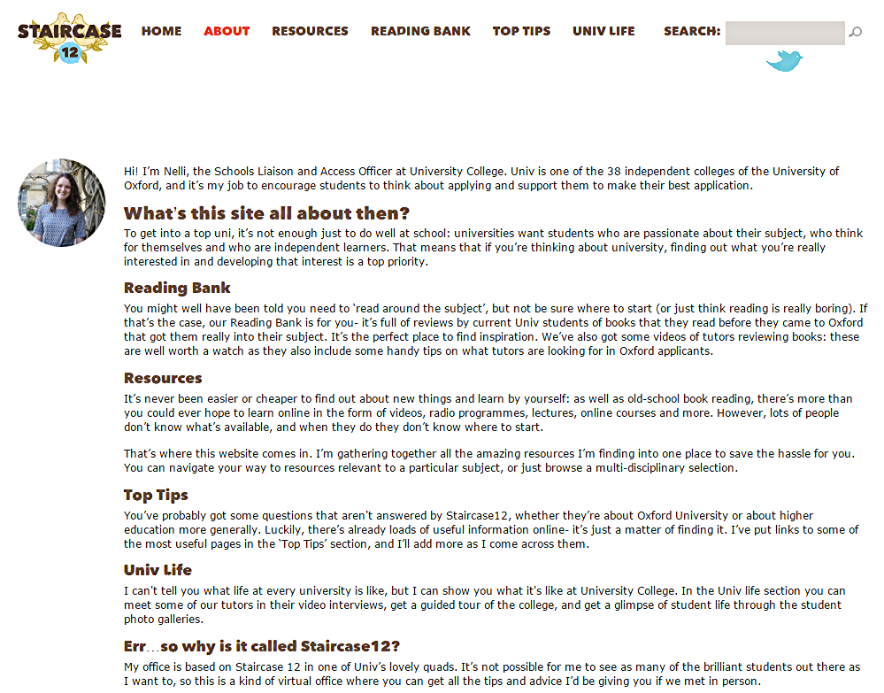
University College Oxford has its own Super-Curricular Website: Staircase 12

Slide 50

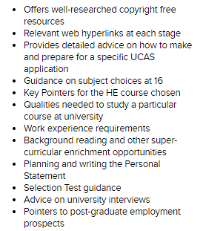
Senior Press Degree Course Application Guides: Enrichment, Work Experience and Websites
http://www.seniorpress.co.uk/listings/category/resources

Slide 51
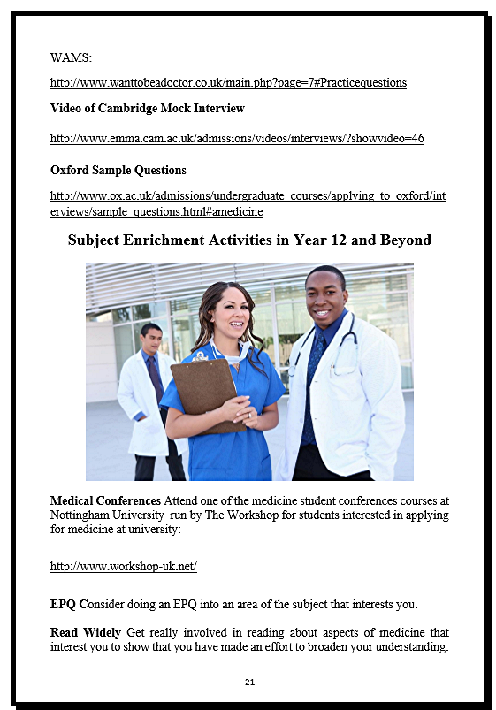
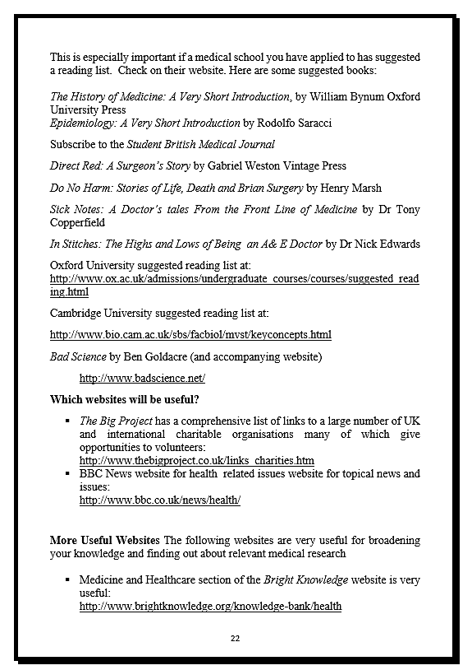

Slide 52



Find Out More About the Subject You Want to Study
£5 or less on Amazon
The Oxford University Press (OUP) series of books Very Short Introductions give an excellent background to the major academic subjects

Slide 53



Subject Guides

Slide 54

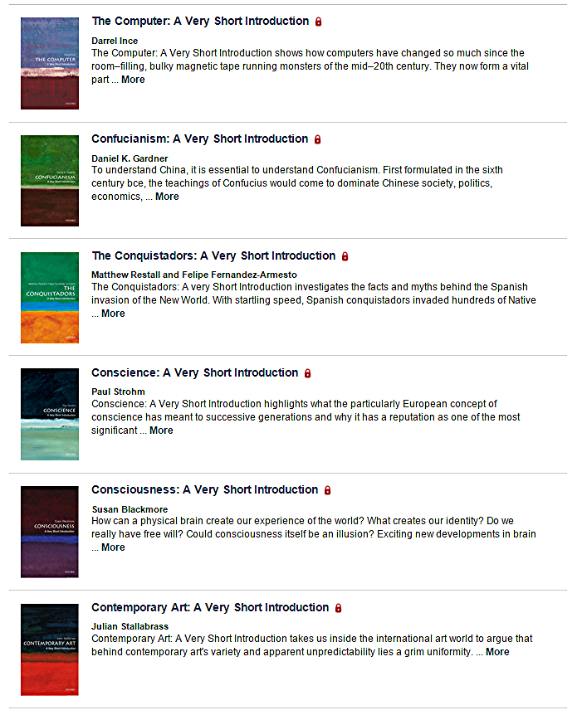
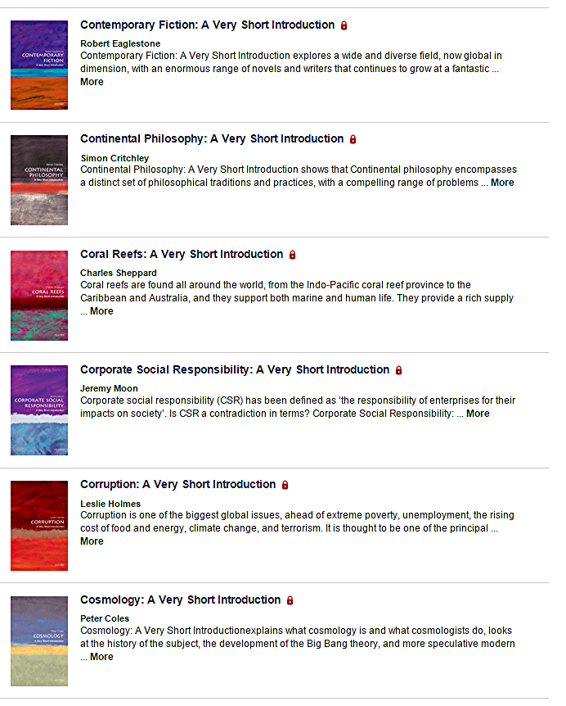

Slide 55

Use Cambridge HE+ Website to find our about the Latest Research
http://www.myheplus.com/

Slide 56
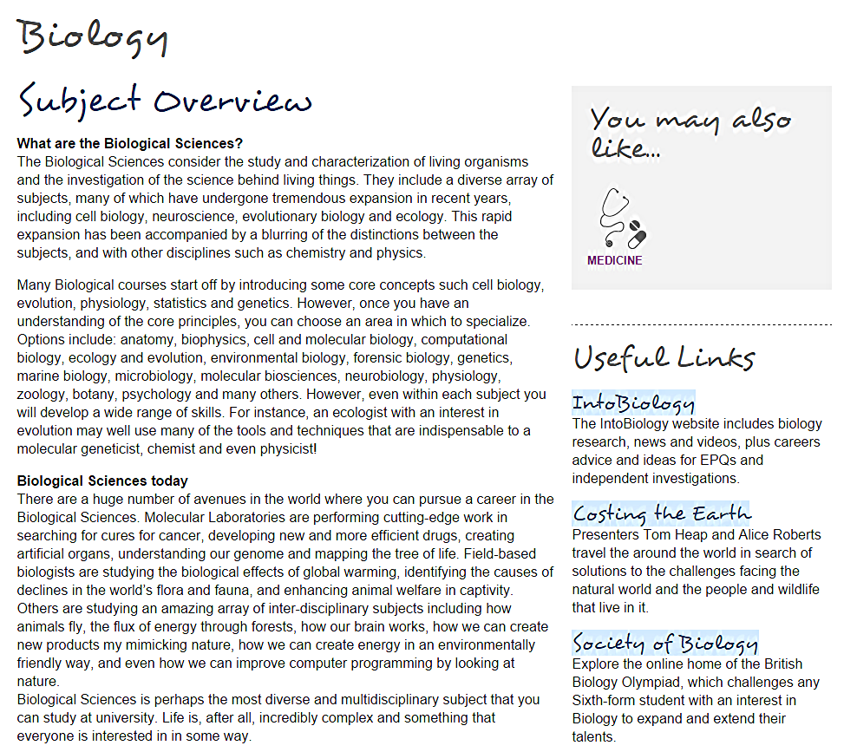


Slide 57

Links to Key Websites

Slide 58
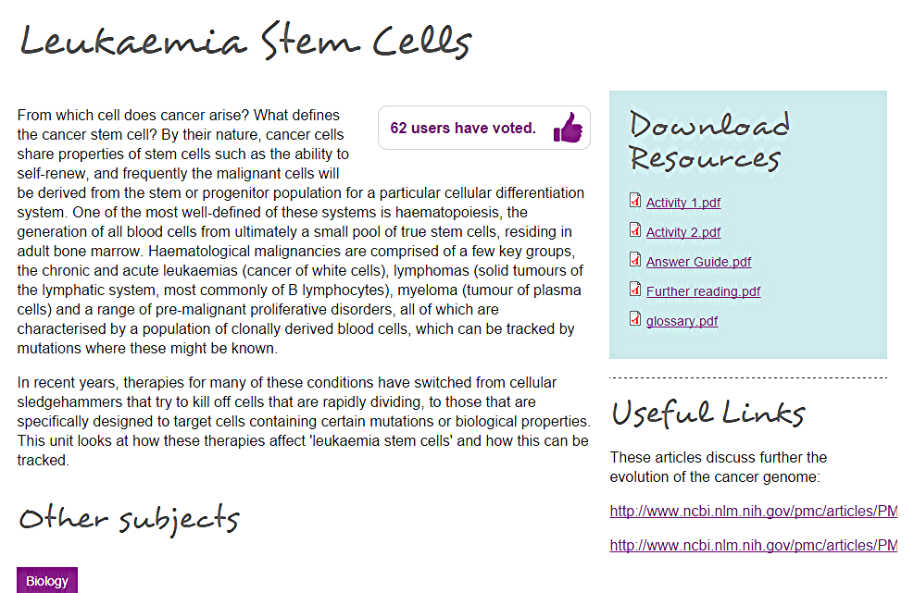
Explore New Topics

Slide 59



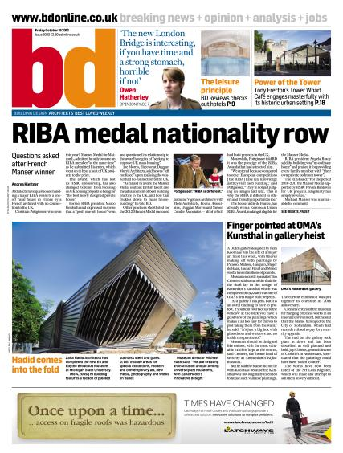


Read Subject Magazines

Slide 60

Subscribe to Philip Allan A Level Magazines
£38 library subscription for 3 or 4 issues + online resources
https://www.hoddereducation.co.uk/magazines/Print-Magazines

Slide 61


Keep up to with Relevant Events with Newspapers and their Websites

Slide 62
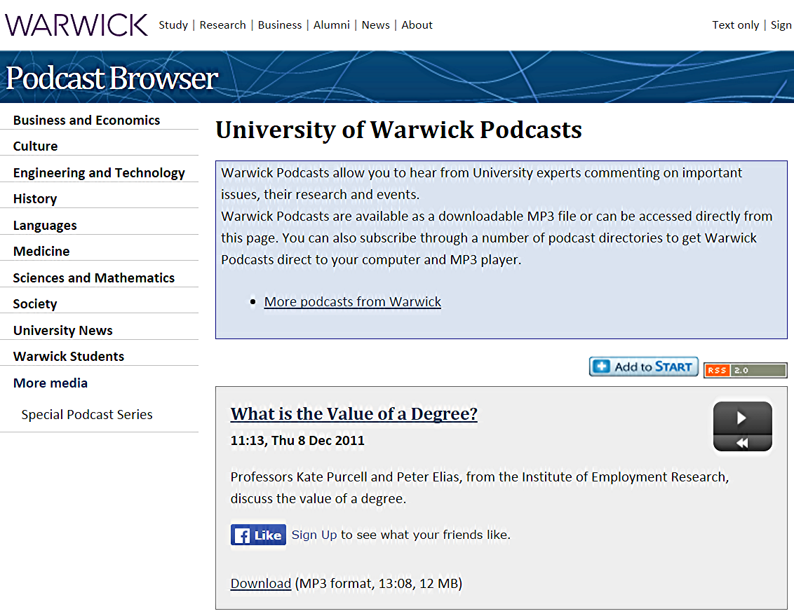
Use Relevant Podcasts
http://www2.warwick.ac.uk/newsandevents/podcasts/media/

Slide 63
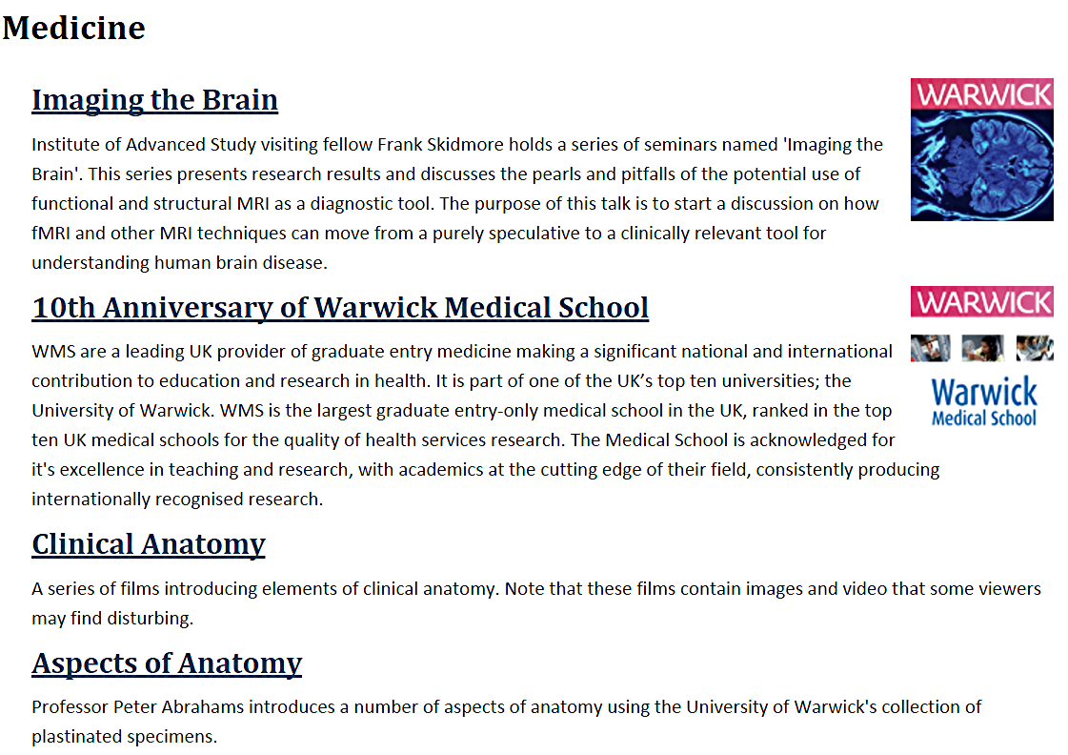


Slide 64


I Tunes U App
iTunes U is a learning resource offering free educational content that users can download from the iTunes Store straight to their computer or mobile devices.
iTunes U has new research and lectures by academics from all the top universities in the UK and abroad
It also features specially commissioned topical pieces in which academic experts contextualise events, for example, the re-launch of the Large Hadron Collider and the 40th anniversary of the Internet.
It has a more limited website which can be accessed on PCs and Android devices

Slide 65

Watch TED Talks
https://www.ted.com/talks

Slide 66


Use TV and Radio Catch Up Archives

Slide 67

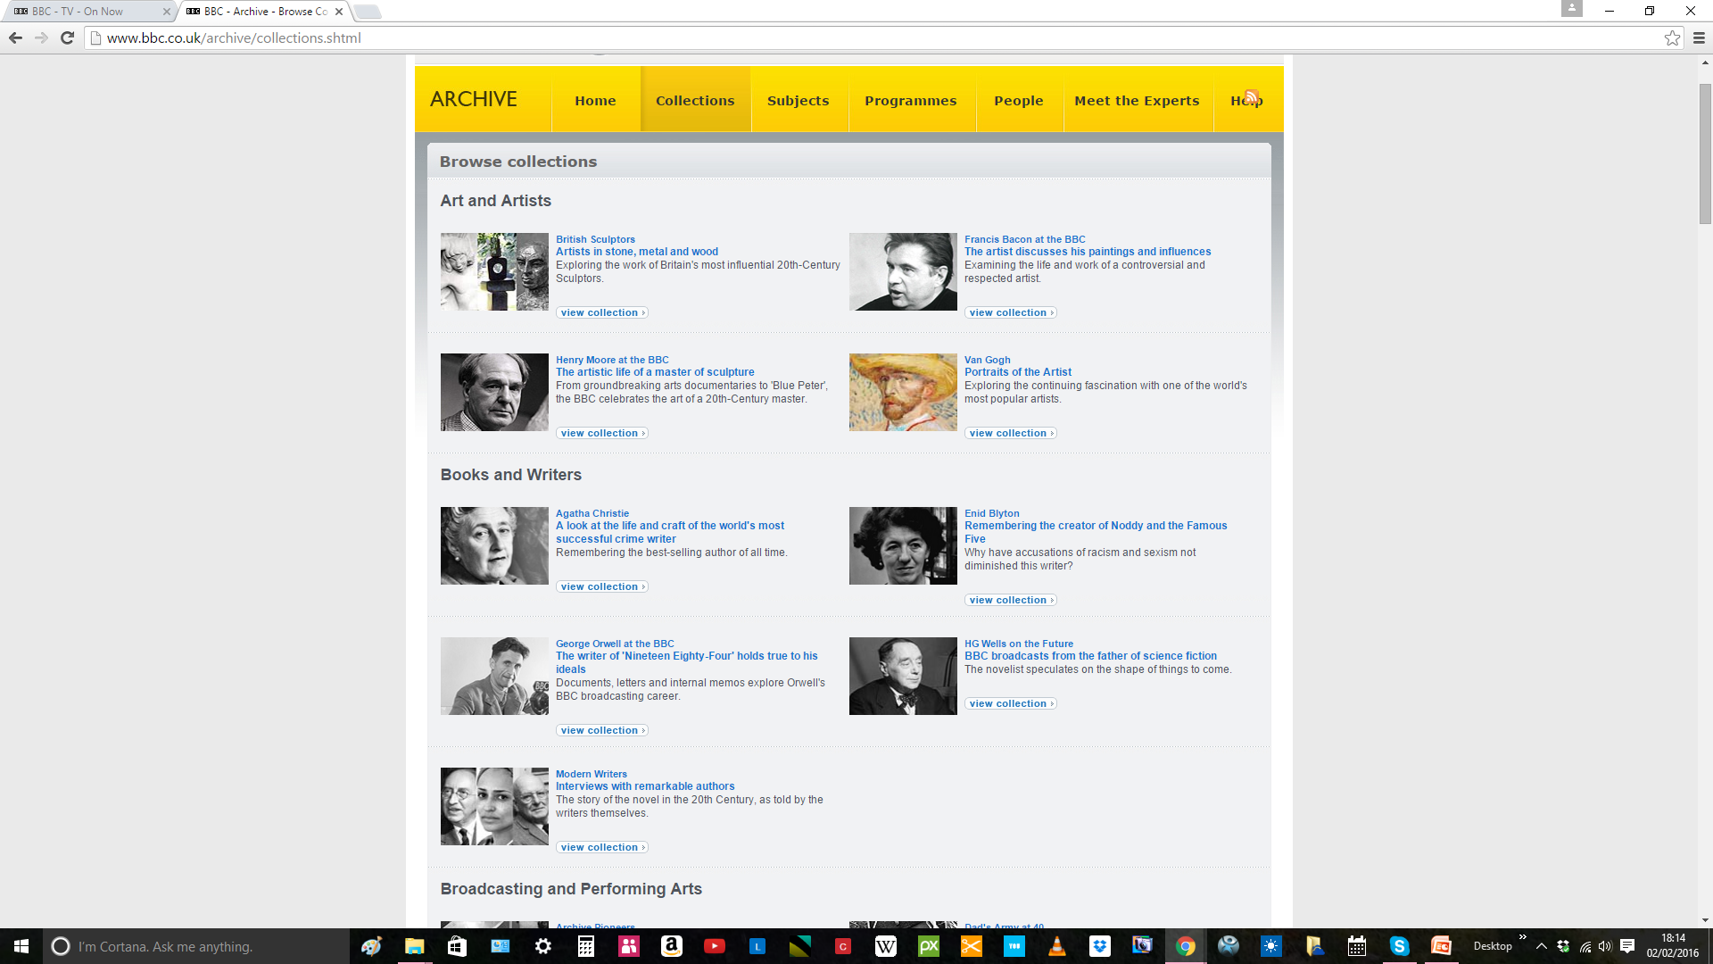
BBC Programme Archive http://www.bbc.co.uk/archive/collections.shtml

Slide 68


Get Relevant
Experience
This depends on the subject you want to study. Some subjects like Medicine or Vet Science require extensive work experience and it is expected for subjects such as Nursing, Teaching or Social Work.
For other subjects you should try to gain relevant experiences in the world outside school such as theatre visits for English, industrial and business experience for subject such as Economics, Business Studies and Engineering, voluntary work for caring careers.
Work experience will also enable you to test the water in terms of potential careers

Slide 69


Medicine Work Experience:
Case Study
By the time you send off your UCAS application in early October of Year 13 you will need to have completed extensive work experience
Start in Year 12
3-4 weeks or more BUT check specific requirements
Range of different experiences in variety of settings eg hospital work, GP, voluntary wrok in socially different areas
Keep a diary/journal of insights but not just descriptive

Slide 70


Keep a Super-Curricular Activities Record for Personal Statements and Interviews
What did you do?
What was interesting, significant and relevant?
How was your perception or view of the subject matter changed?
What did you agree or disagree with and why?
What further questions were raised?
What could you do to explore these questions further?
What skills or understanding were developed?

Slide 71
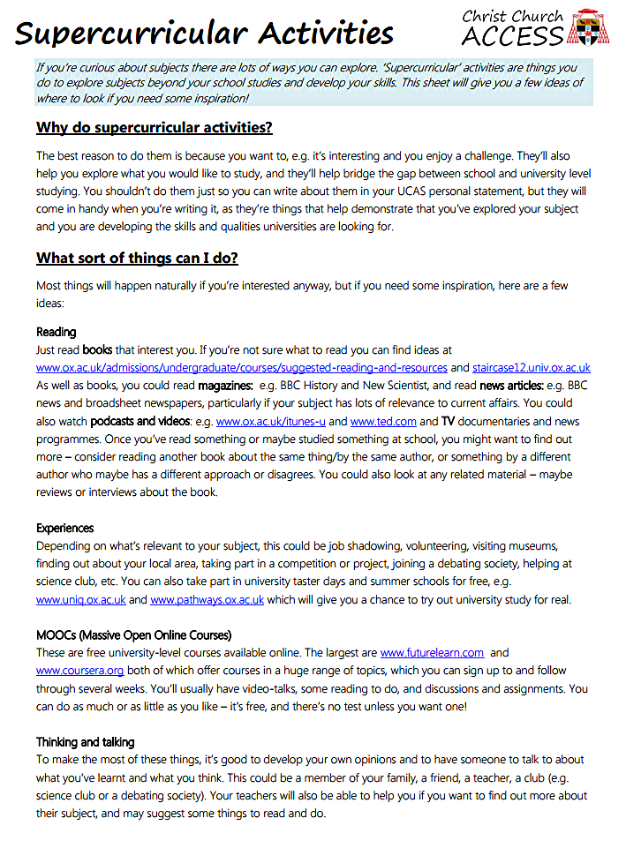
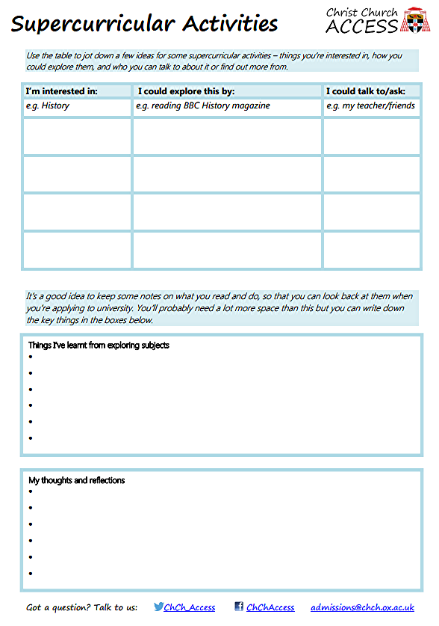
Christ Church Oxford: http://www.chch.ox.ac.uk/admissions/access-and-outreach/resources

Slide 72

No-one Expects
You to do all 10!!
Choose a few topics or issues in your subject to follow up in depth using a variety of the 10 resources
As a bare minimum use Short Introductions series, a subject magazine and its back-numbers, wide reading or challenging problems (say in Maths)
Develop an area of interest in the subject but outside the exam spec
Find out much more about something in the spec that interests you
Above all, be able to show knowledge and enthusiasm

Slide 73



What about Extra-Curricular Activities?
Interests outside your subject are important for your own all-round development
They show you can manage your time and deal with the competing pressures of academic life
BUT the more competitive the course the less significant they are and it is super-curricular activities that will make the difference

Slide 74



But
BUT Don’t Forget to Keep Your Eye on the Exam ‘ball’

